Slide 1
Escape from Mount Blaze
Kriston Che

Slide 2
Concept
A game where you have to avoid potholes of lava, and fireballs to get to one of two end points. The player will be able to walk, run, and jump. They will also be able switch between third person view and first person view by pressing a key.
Design:
The game is set on a rocky terrain with dim, dark lighting. Player will navigate around the dark rock mountains that has potholes of lava. There are two glowing checkpoints at the end of the map.
Rules:
Avoid oncoming projectiles to not respawn. Avoid potholes of lava to not respawn. Reach one of the two checkpoints to complete the game.

Slide 3
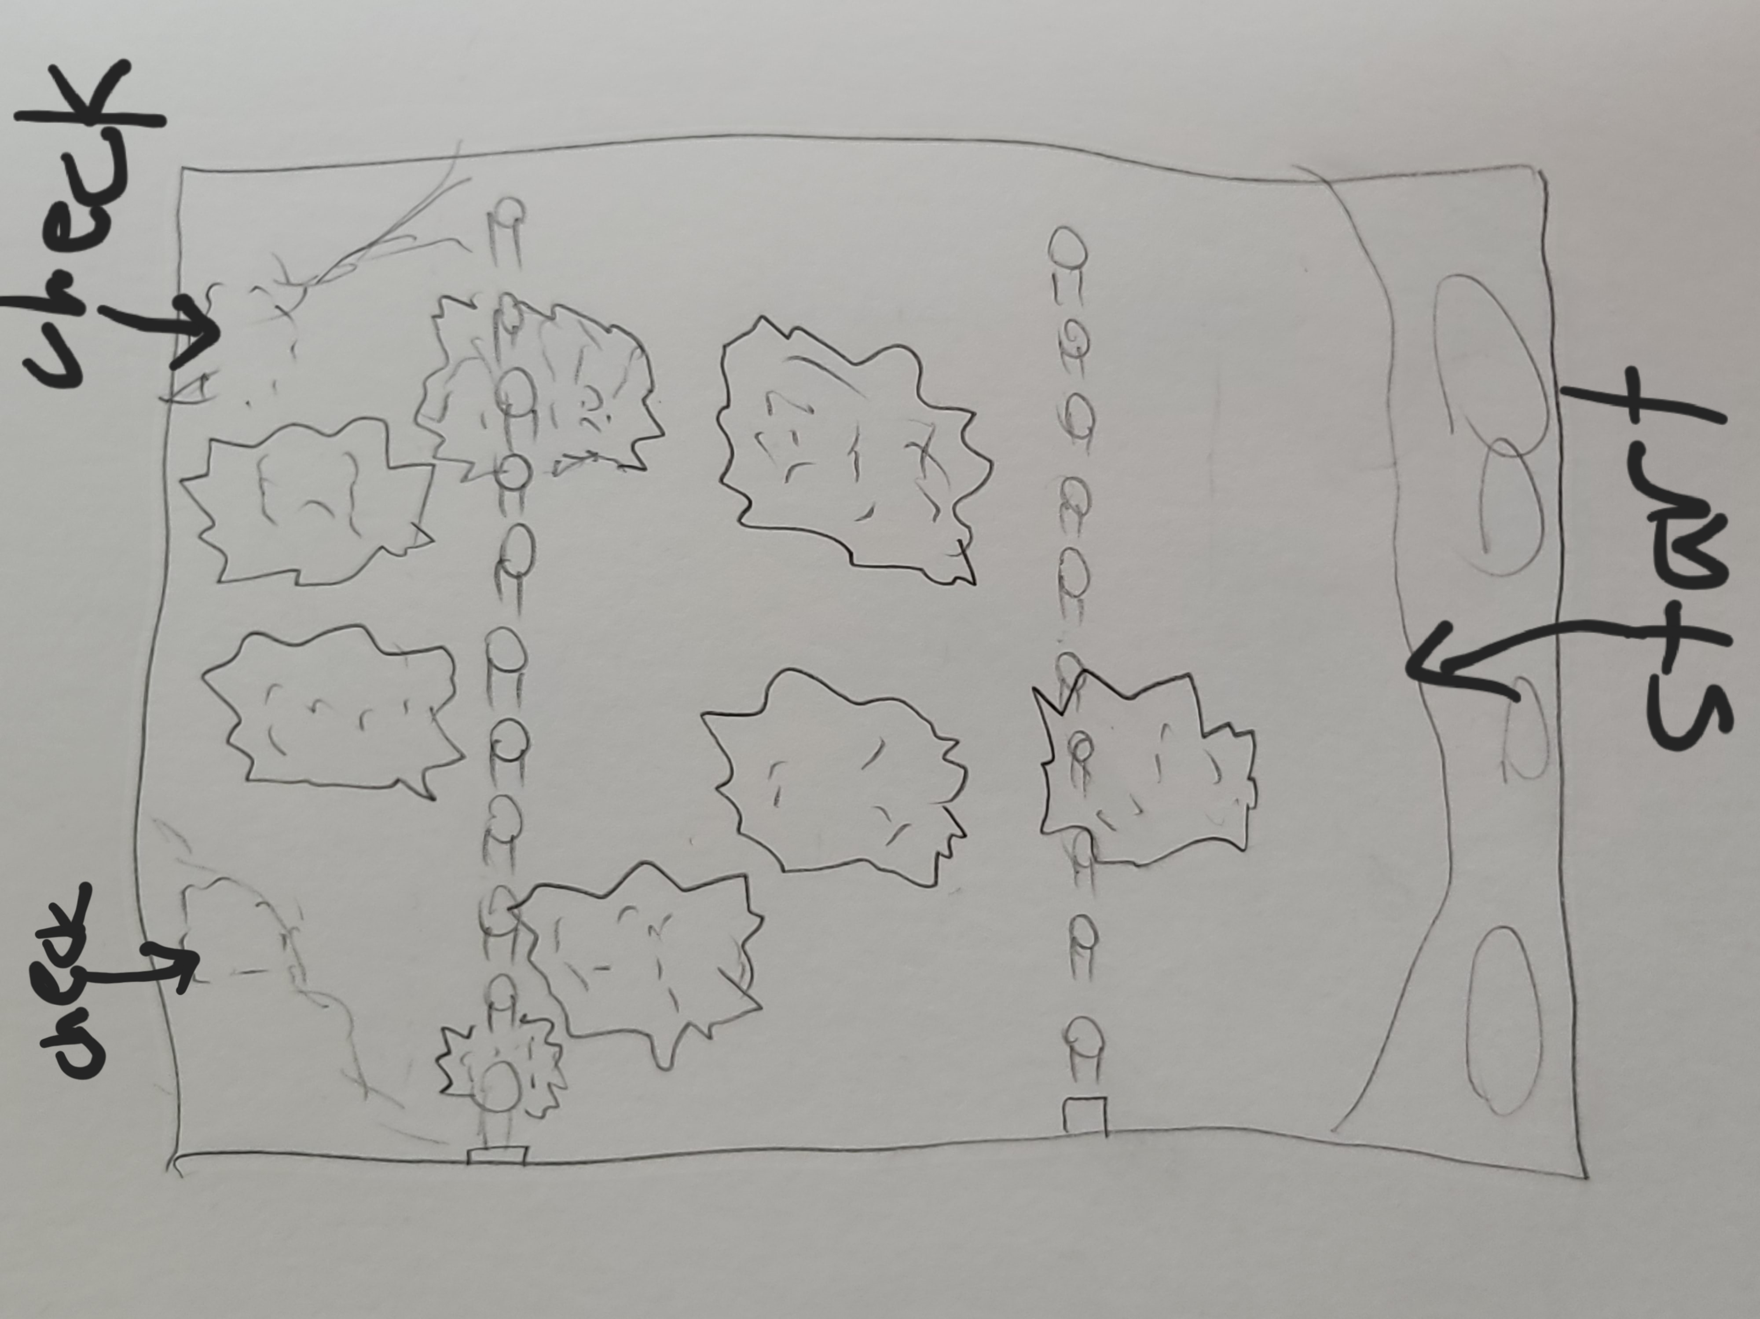
Bird’s Eye View

Slide 4
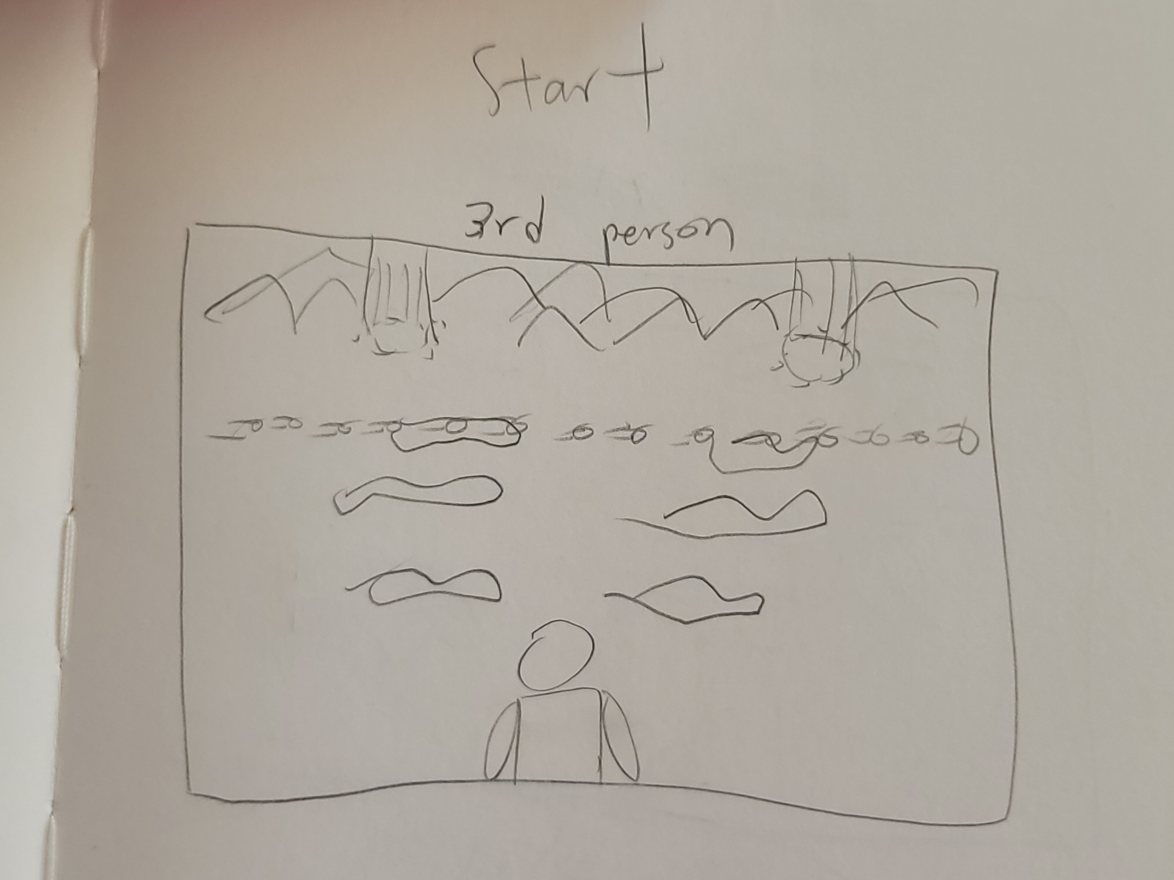
Start (3rd Person view)

Slide 5
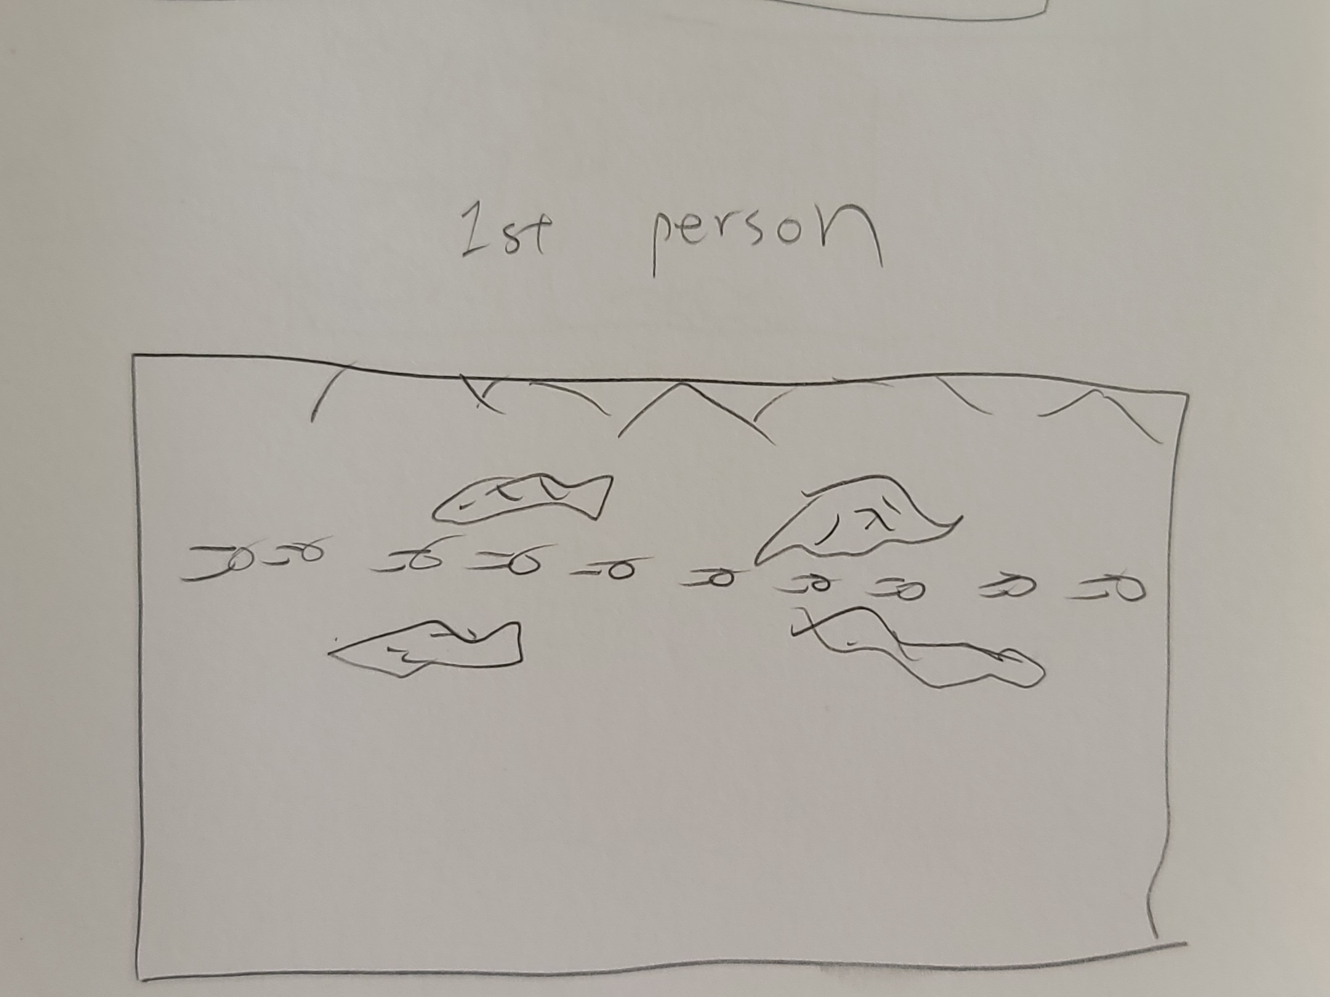
Start (1st person view)

Slide 6
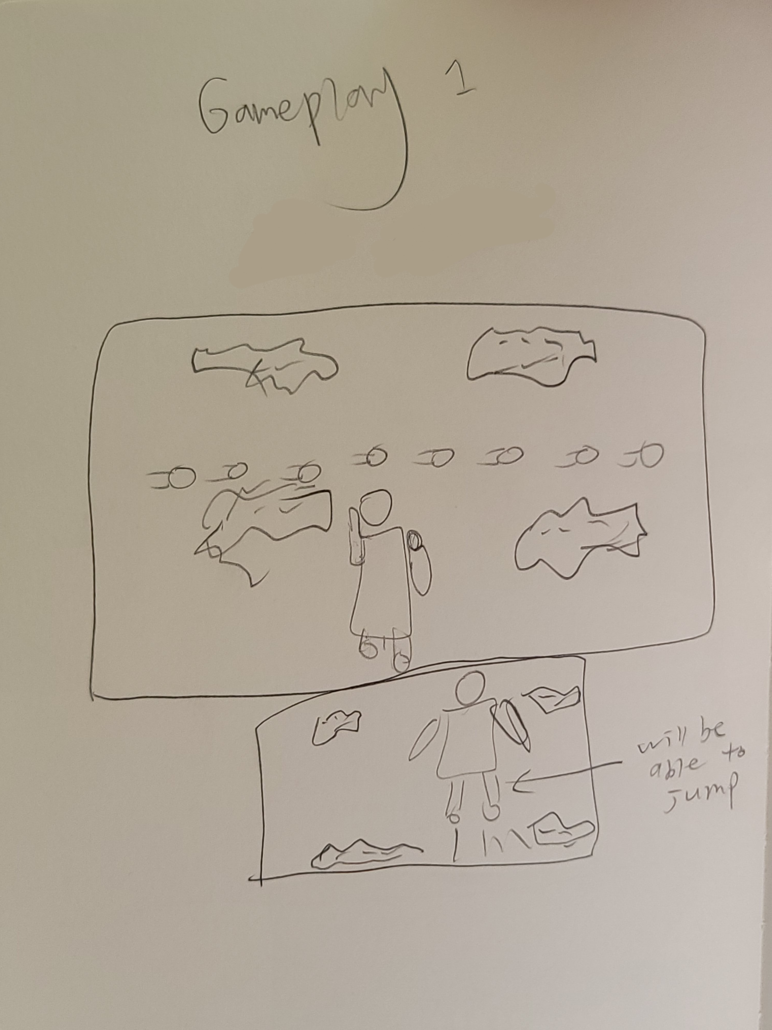
Gameplay

Slide 7
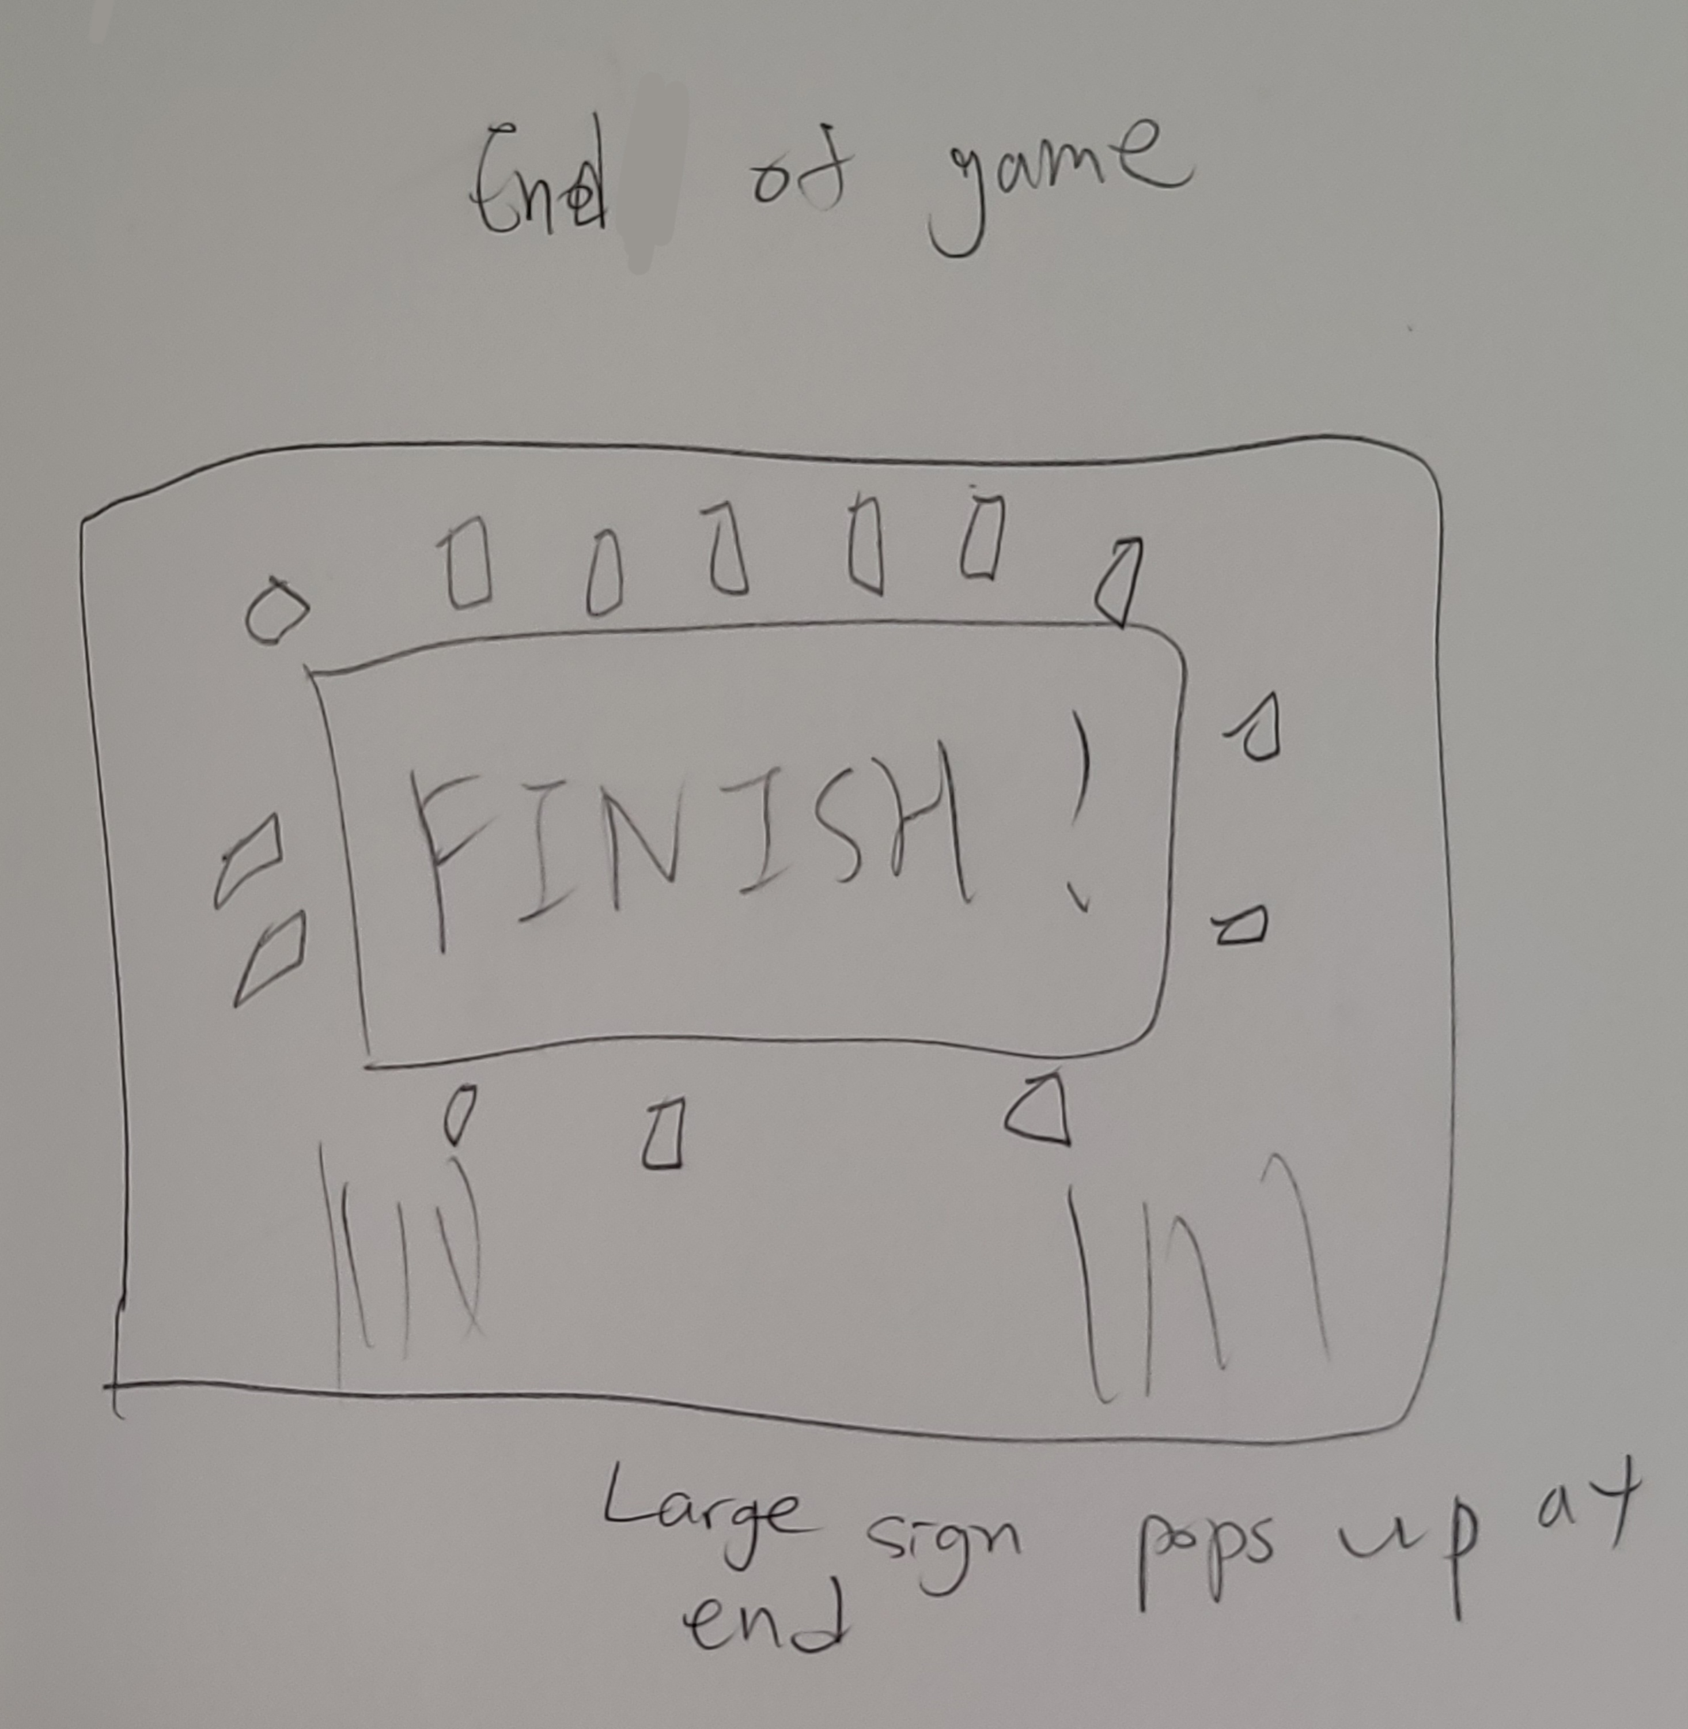
End of Game

